Slide 1
Distributed Operating systems IOT Project
Team 6: Yuan Zhou, Jianing Cui, Zhixin Pan, Nimish Jindal, Natasha Mandal

Slide 2
Part 1 Device drivers

Slide 3
Device introduction
We use 4 devices in this project, tmp36, button, LED and buzzer.
We also use three breadboards, some resistors and jumper wires to connect the circuit for these devices, where tmp36 is connected to a BBB, 2 buttons are connected to a BBB, and a LED and a buzzer are connected to the third one.

Slide 4
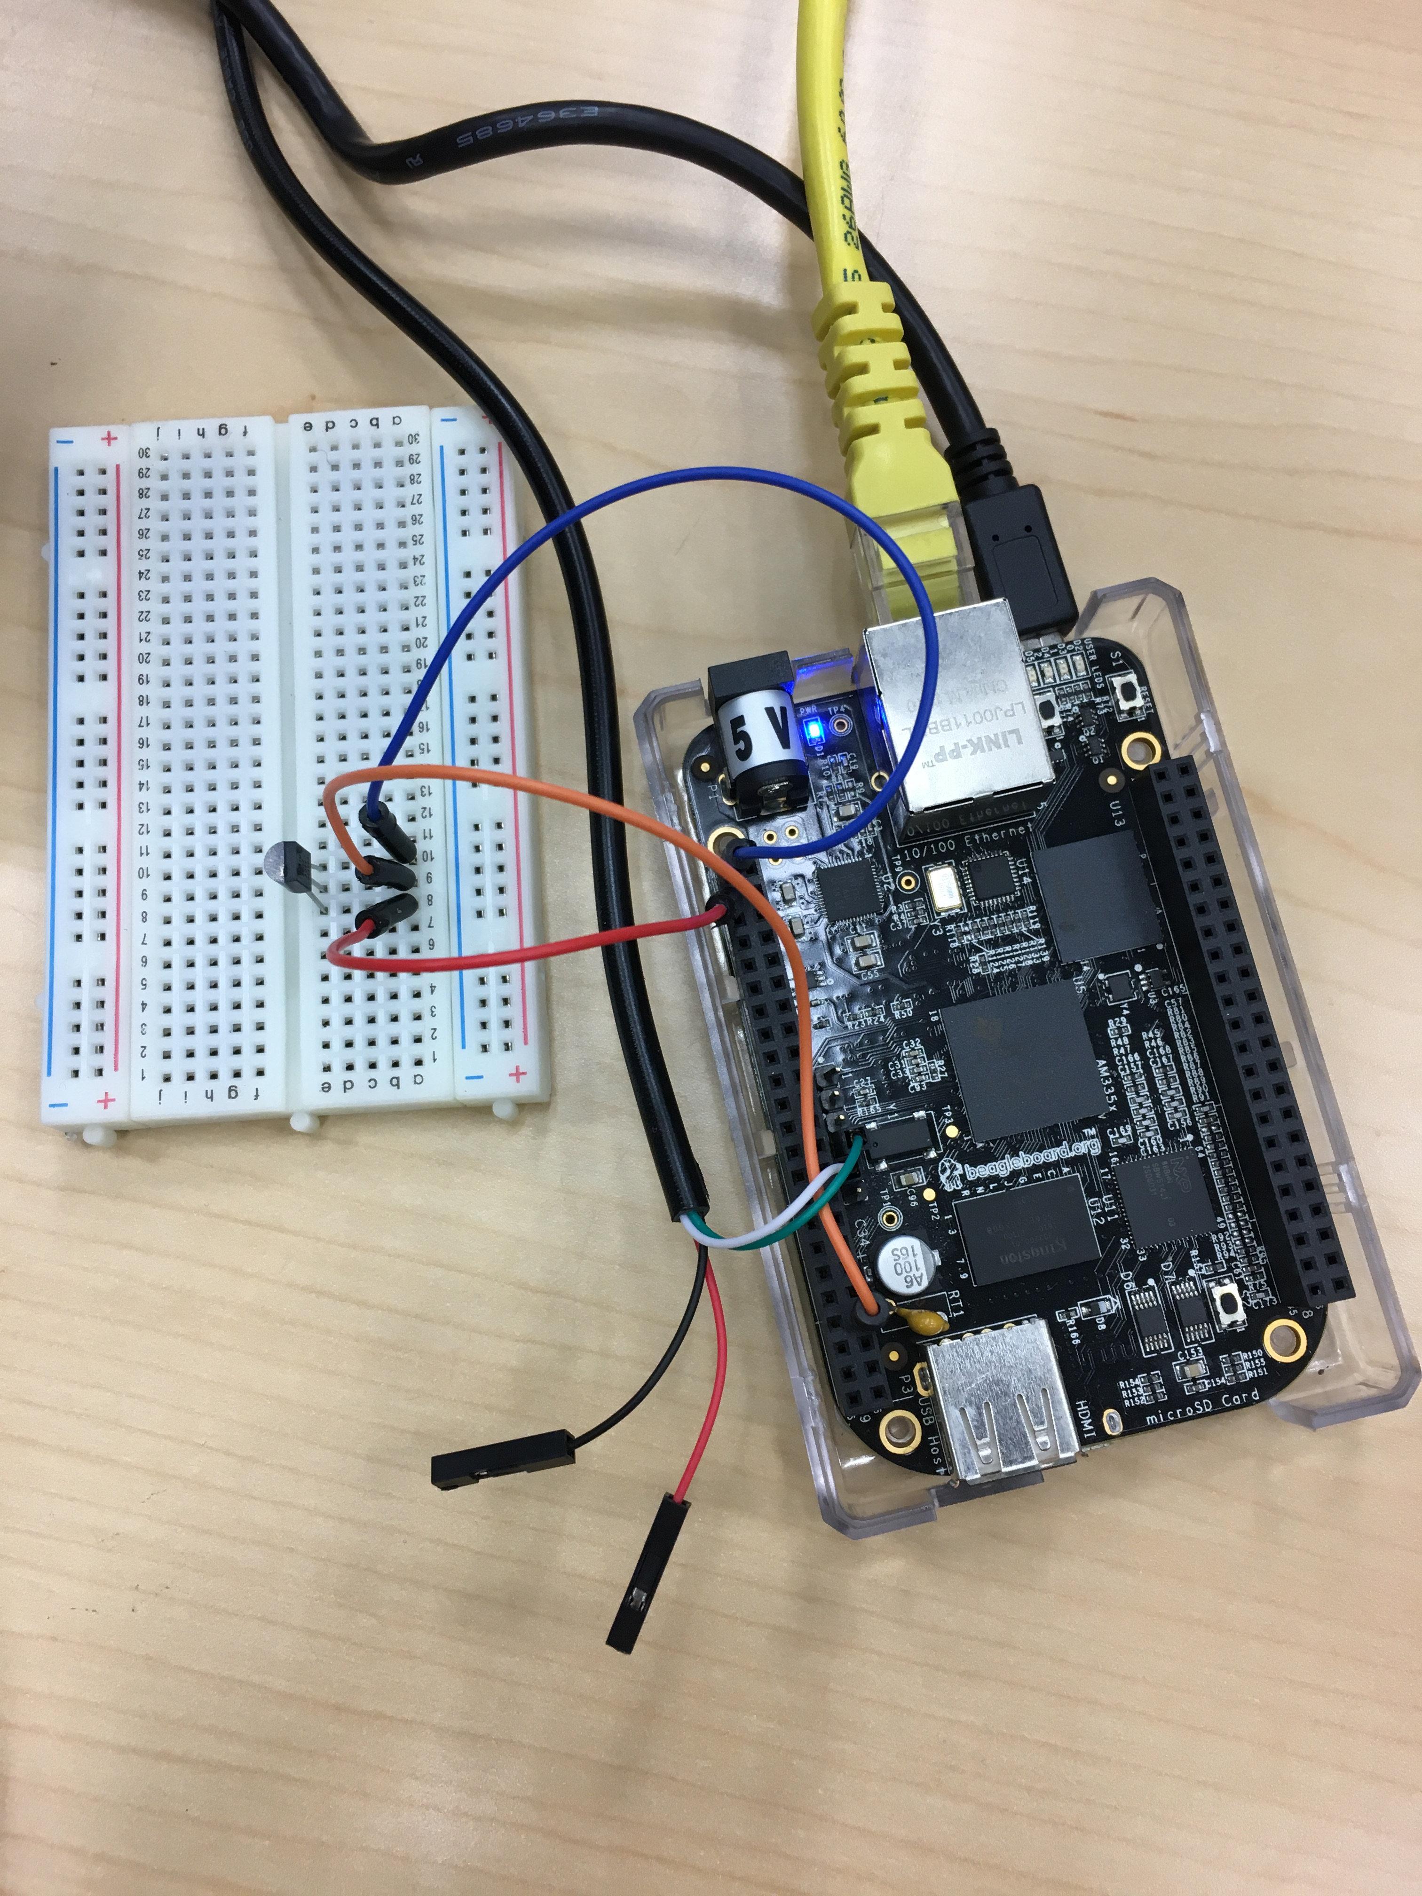
Devices – tmp36
Tmp36 is a high accuracy solid state temperature sensor. It can detect temperature from -40 Celsius to 150 Celsius with 2 Celsius accuracy.
The circuit for tmp36 is shown in the figure. In practice, the power pin is connected to (P9, pin 3) of the BBB, which has 3.3V, the ground pin is connected to (P9, pin 1), and the data pin to (P9, pin 40), which is the AIN1.

Slide 5
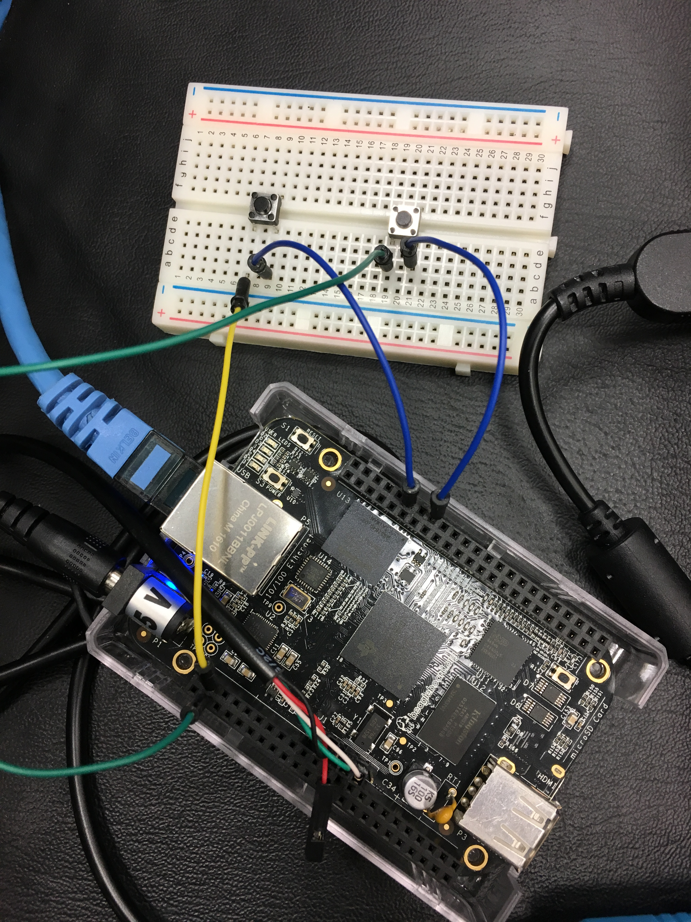
Devices - buttons
The circuit for the 2 buttons is shown in the figure.
They are connected to the GPIO pins.

Slide 6
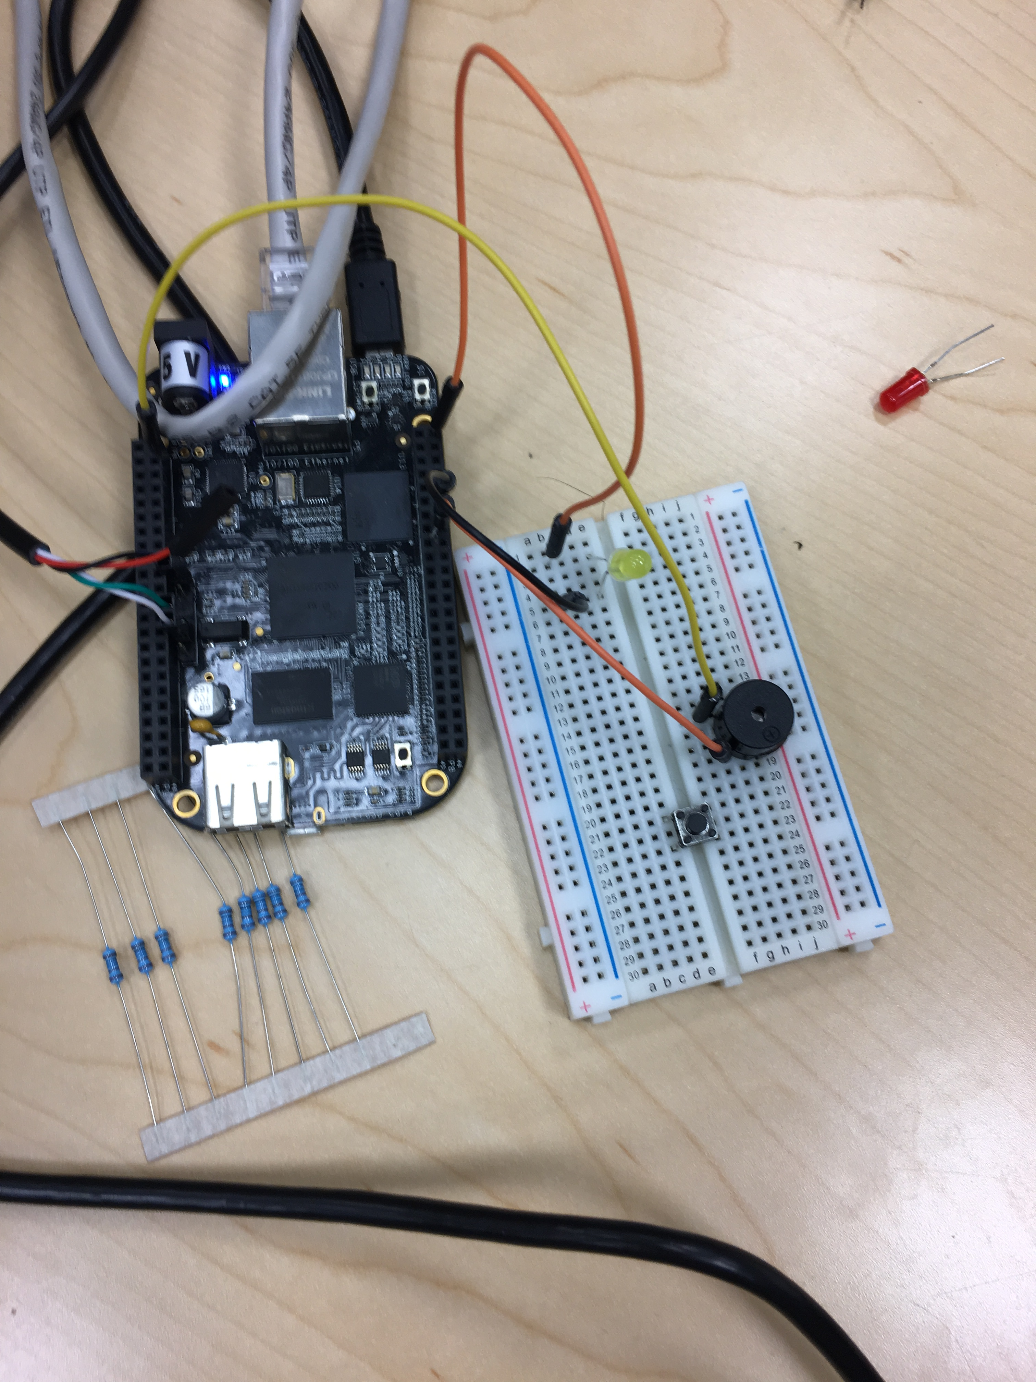
Devices – led and buzzer
The circuit for the LED and Buzzer is shown in the figure.
They are connected to the GPIO pins.

Slide 7
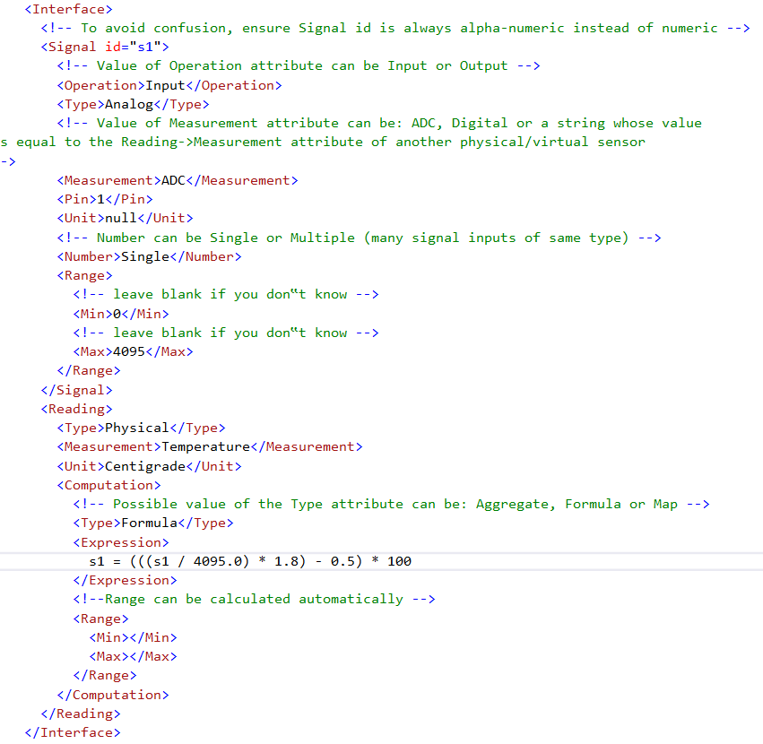
DDL XML file
The part that relates to driver generation for tmp36 is shown in the figure.
The nodes that we use are id, Operation, Type, Pin, Expression, etc.

Slide 8
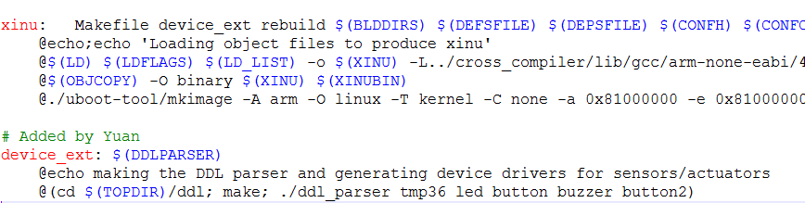
Driver generation
Makefile

Slide 9
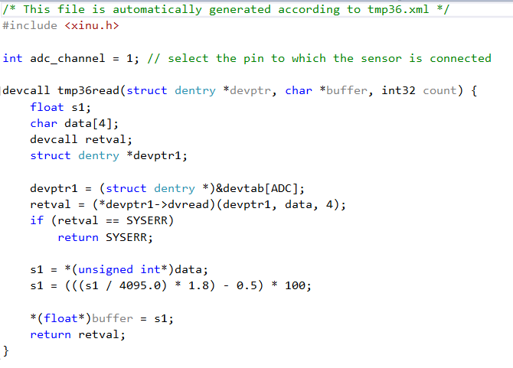
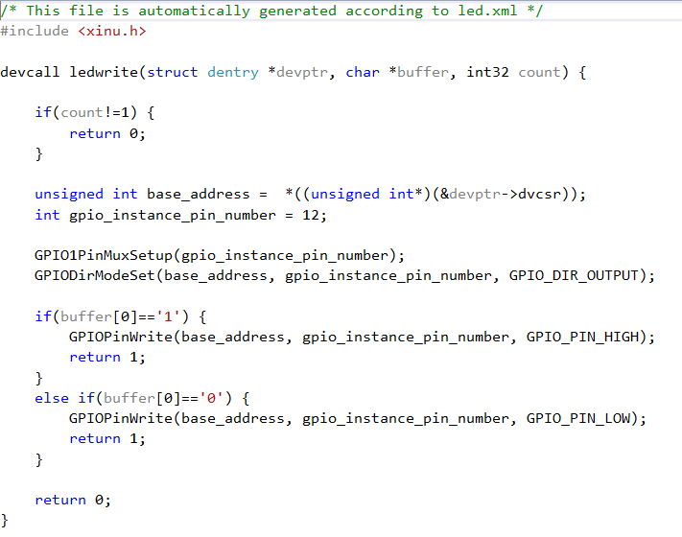
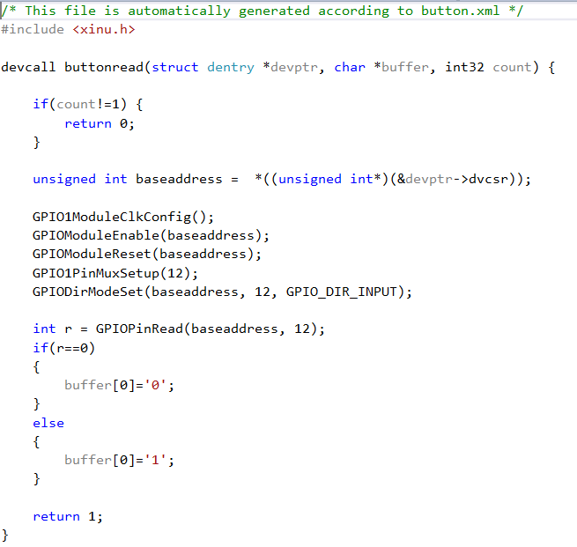
Generated drivers
tmp36read
ledwrite
buttonread

Slide 10
Part 2 IOT

Slide 11
overview
We use 1 cloud server, 3 edges, 3 BBBs, 4 devices.
Edge 1 is connected to a BBB with tmp36.
Edge 2 is connected to a BBB with 2 button.
Edge 3 is connected to a BBB with 1 LED and 1 buzzer.
The server and dashboard is on another computer.
We use MQTT for communication between edges and cloud, UDP between edge and BBB.

Slide 12
Use case
Show temperature
BBB with tmp36
Edge 1
Dashboard
Press button 1, toggle LED
BBB with button
Edge 2
Edge 3
BBB with LED
Edge 3
Dashboard
Press button 2, toggle buzzer
Similar to above
Use dashboard to control LED
Dashboard
Edge 3
BBB with LED
Edge 3
Dashboard
Use dashboard to control buzzer
Similar to above

Slide 13
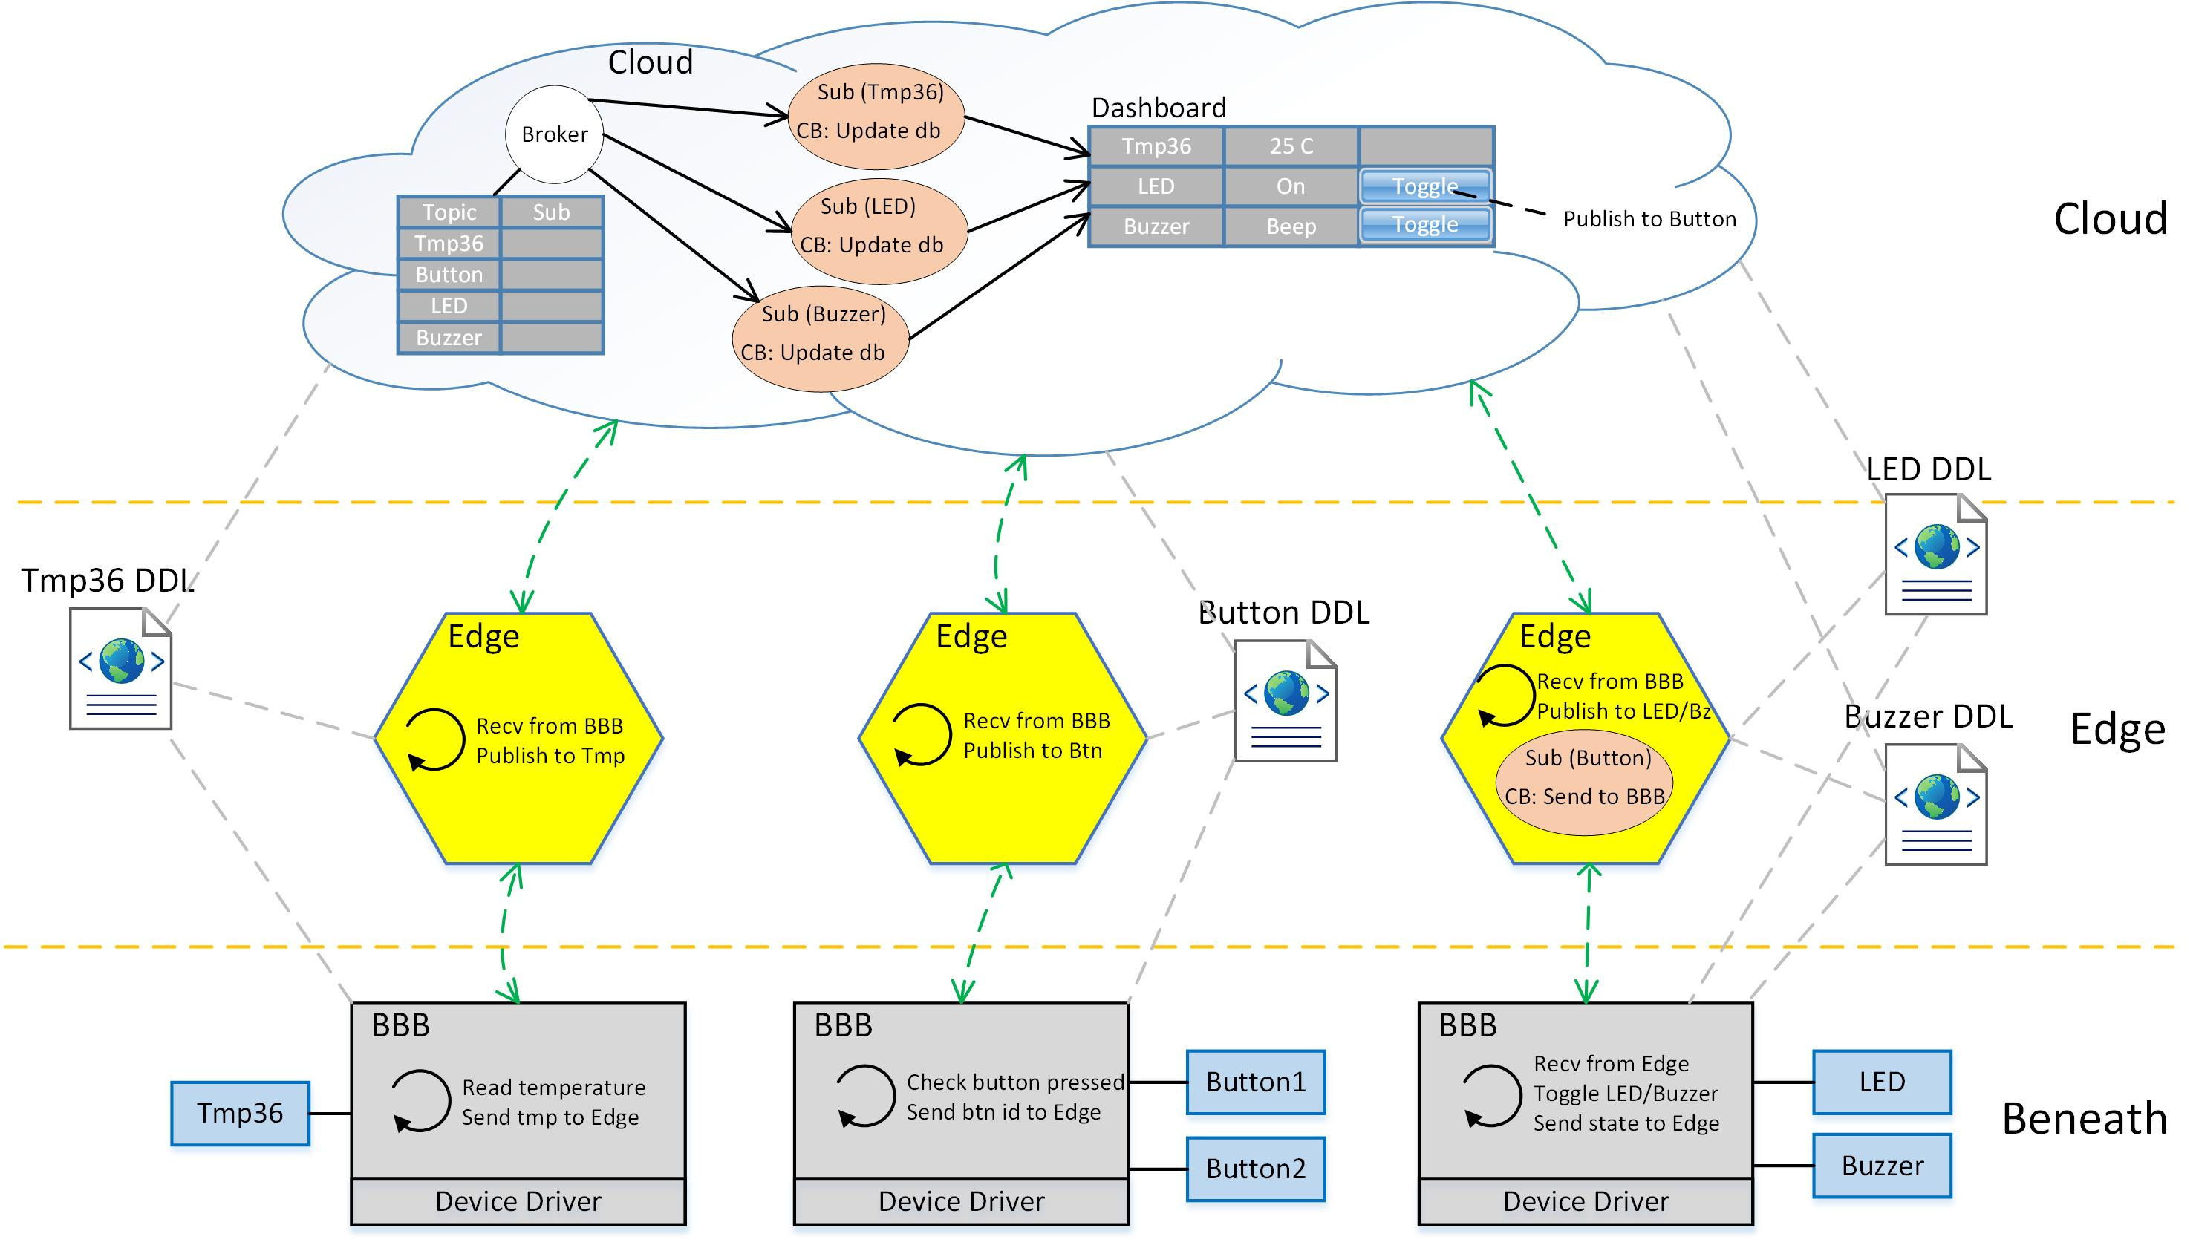
Architecture

Slide 14
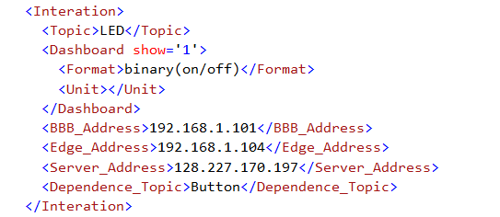
DDL XML file
The figure shows the part of the DDL file used in Part 2 for the button.
It contains topic for subscribe in the cloud (publish in the edge), whether it is shown in the dashboard, its dependence of button, and various addresses.

Slide 15
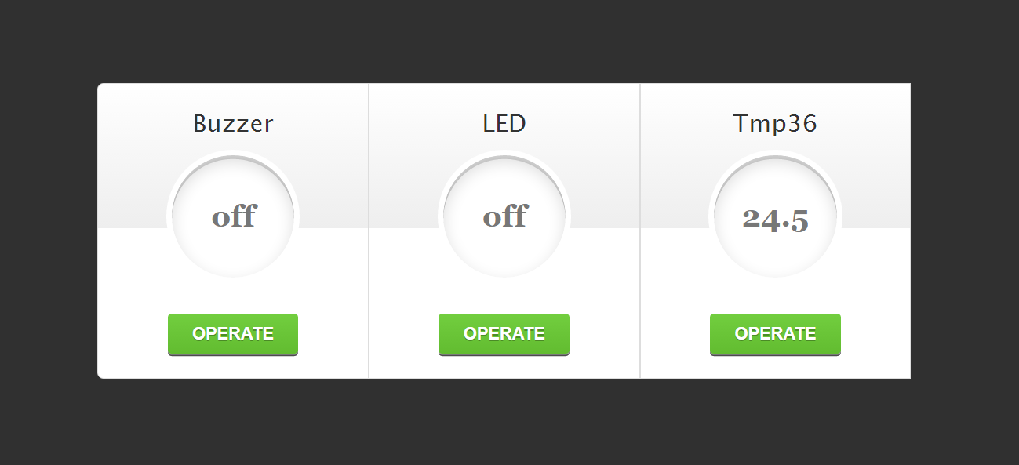
Dashboard in the cloud

Slide 16
results

Slide 17
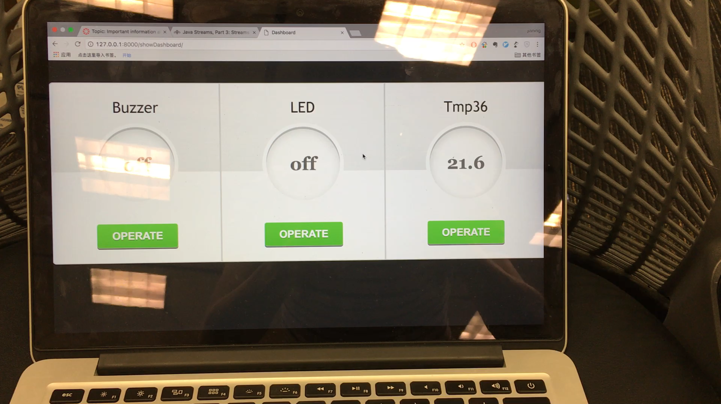
demo

